Slide 1
Avery Dennison InvEnt Idea: VEBS- Vehicle-fitness Ensuring BIOS Setup Presenter: Yashika Behl Indira Gandhi Delhi Technical University for Women Bachelor of Technology, CSE Sophomore

Slide 2
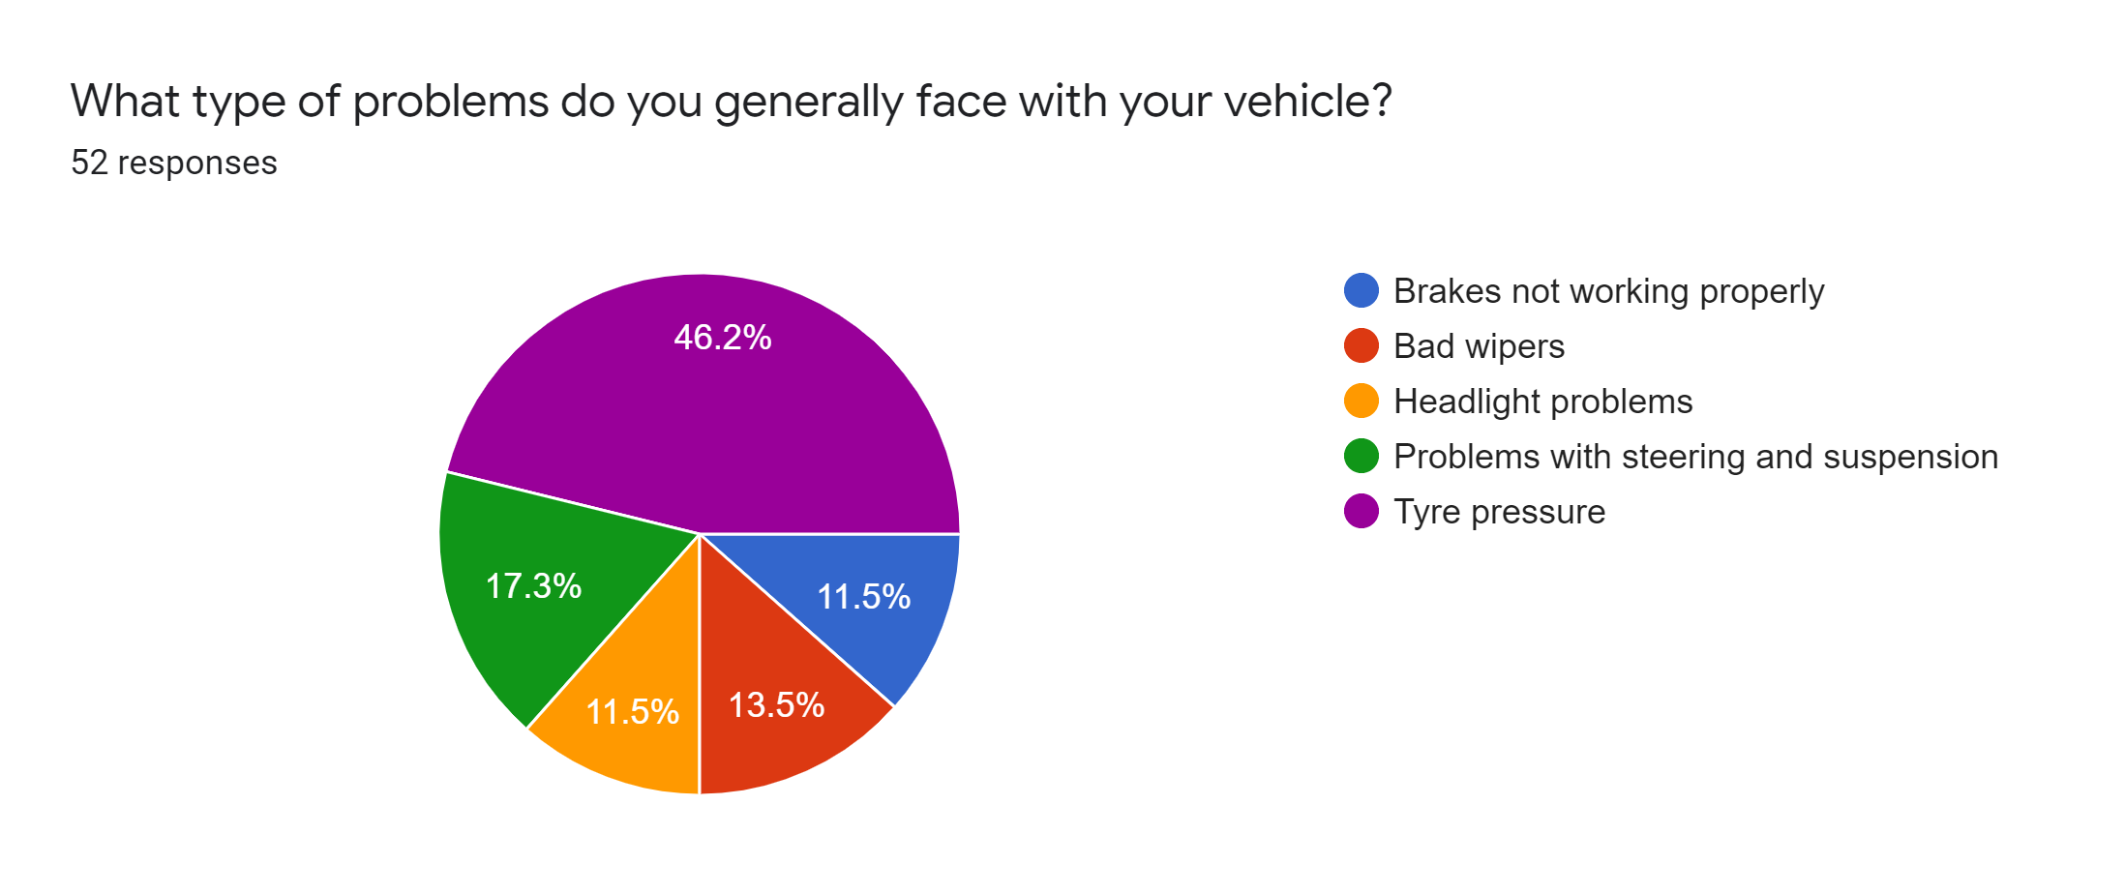
Impact Analysis of the Problem
India has been on the top of list of countries with highest number of road fatalities since 2009, according to the first Global Status Report published by WHO. The cause of these accidents can be human errors, but studies show that vehicle defaults are a major reason of proliferating road accidents.
According to the National Highway Traffic Safety Administration (NHTSA), tire problems account for 35% of accidents where vehicle failure is the main cause of crash, brake issues comprise 22% of accidents.
Hence, The problem being addressed is “Aggravating number of deaths due to road accidents.”
Results of survey conducted by the applicant

Slide 3
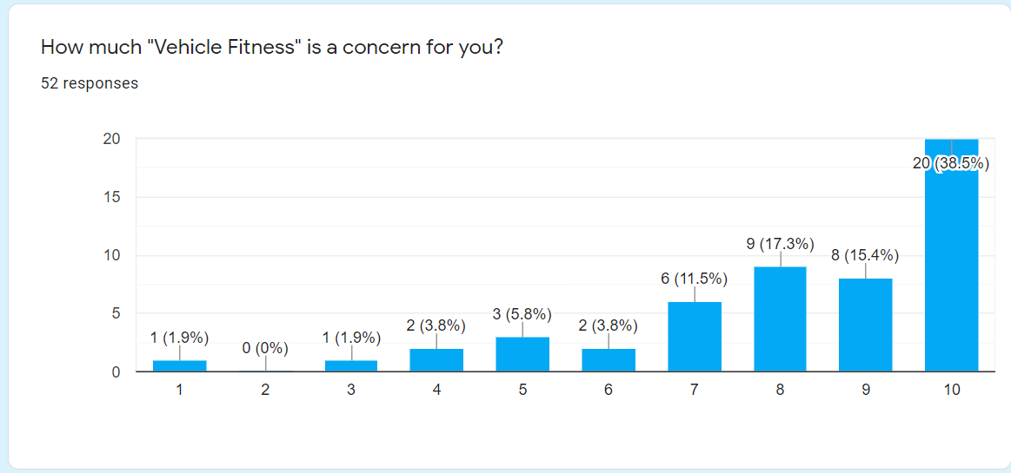
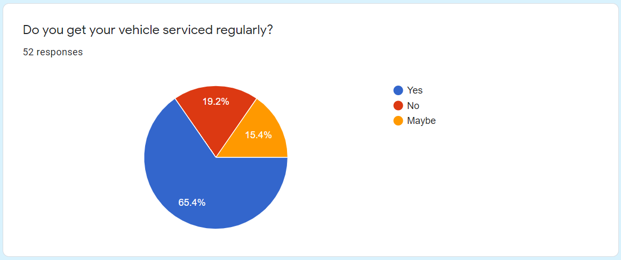
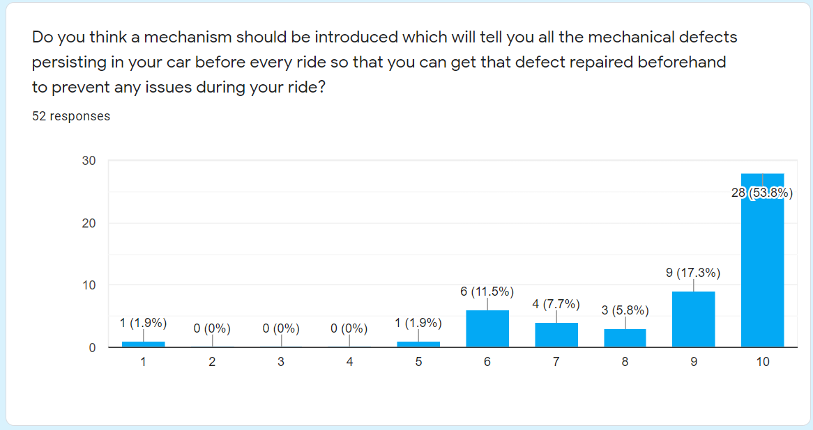
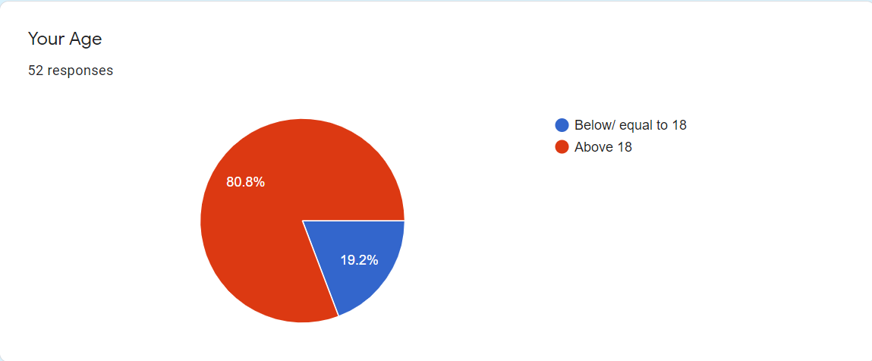
Statistics and Surveys Conducted

Slide 4
Solution: VEBS (Vehicle-fitness BIOS Setup)
When a computer is turned on, POST (Power-On-Self-Test) starts which is the diagnostic testing sequence that the computer’s BIOS run to determine whether all the devices are working properly or not. The POST, working on the same conditions will be installed in the vehicles.
The following devices connected to our MPU (main processing unit) will detect the defects:-
1.
BRAKES DEFECTS: BRAKE WARNING LIGHT
2.
PRESSURE ANALYSIS AND AUTOMATIC PUMPING OF BLOWN OUT TIRES.
3.
INOPERATIVE HEADLIGHTS: LIGHT SENSOR
4.
FOR AUTOMATIC OILING OF STEERING AND SUSPENSION
5.
FOR ASSURED USE OF SEATBELT
5.
FOR BAD WIPERS

Slide 5
Step-Wise Implementation Plan
This system will operate certain devices, which in turn, will check the vehicle’s compatibility and will display all the defects on the screen, installed in front of the drivers itself. The main processing unit will operate the POST immediately within about 3-5 seconds after the vehicle is turned on and will display the results on the installed LED screen.
FOR BRAKES
FOR HEADLIGHTS
So whenever sensor is turned on, it will send electric signal to the screen that the headlights are not working.
If the brake warning light will be turned on if there is any fault in brakes, then it will display about the brake on the screen which is at fault.
Sensors will be installed inside the glass of headlights so that whenever it detects light, it is off and whenever there is no light, it turns on.

Slide 6
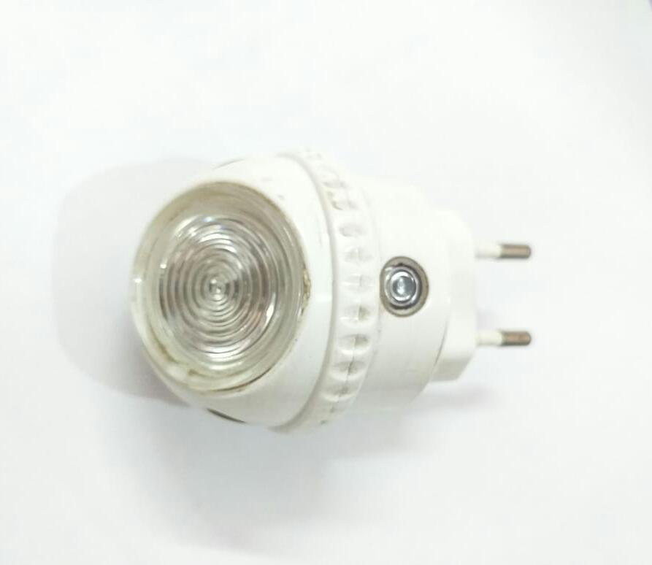
BRAKE WARNING LIGHT FOR BRAKE DEFECTS
LIGHT SENSOR FOR HEADLIGHT PROBLEMS
FOR BLOWN OUT TIRES
We will implant the SIT (Self inflating tire technology) in the vehicle which uses the energy of the wheel to self inflate the tires as needed.

Slide 7
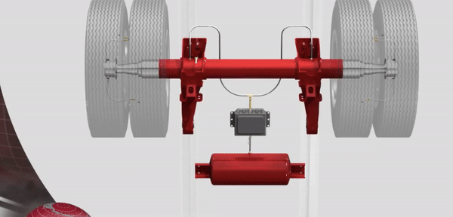
SELF-INFLATION TECHNOLOGY FOR BLOWN-OUT TIRES
FOR STEERING AND SUSPENSION
Whenever steering and suspension lacks oil, the APS (automatic lubrication system) will lubricate it to avoid any stuck in these parts while driving.
Whenever the oil will be below some pre- recognized level, the touch sensor will send information to the screen to have it filled again.

Slide 8
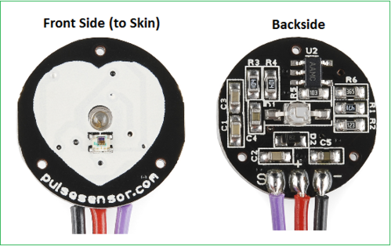
FOR ASSURING SEAT BELT USE
A pulse sensor on seat belt will sense the pulses of the driver, it will radiate electric signals which will be received by the receiver. And the car will only start if and only if receiver has received the signals.
PULSE SENSOR TO ASSURE USE OF SEATBELTS

Slide 9
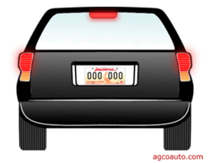
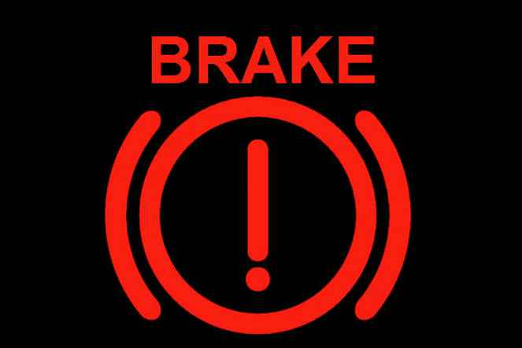
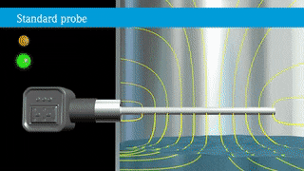
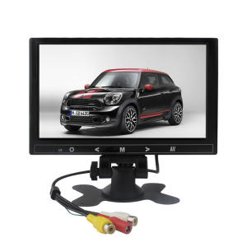
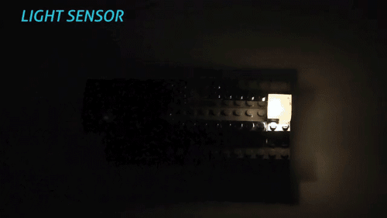
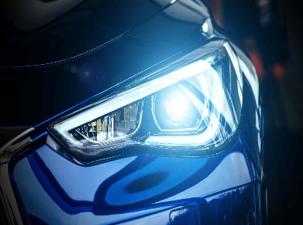

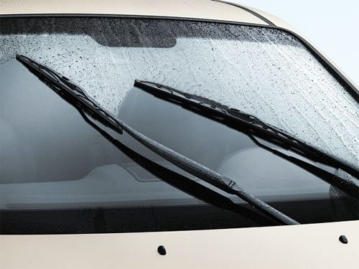
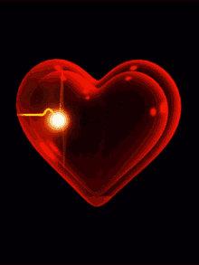
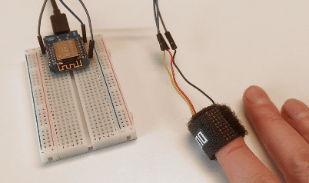
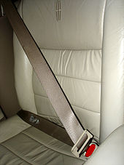
Animated Prototype
For Brakes: Brake Warning Light
For Tire Pressure: Self-Inflation Technology
For Steering: Self-Lubrication system
For Headlights: Light sensor
LED Screen
For Bad Wipers : Touch sensors
For Seatbelts: Pulse Sensors

Slide 10
Uniqueness of the idea
F: FLEXIBLE
I: INTRINSIC
F: FLEXIBLE
A: AFFORDABLE

Slide 11

Let’s prevent road accidents and make VEBS the life-shield of every vehicle and driver.

